Slide 1
SUPPLY CHAIN ANALYSIS
CDACL-003
SOUNAPURAM KAVYA SHALINI
TEAM ID: PTID-CDA-SEP-26-11315

Slide 2
PROJECT OVERVIEW
Analyze supply chain data to identify operational patterns and performance differences.
Compare products, suppliers, manufacturing costs, transportation costs and quality metrics.
Build a Power BI dashboard for comparative supply chain analysis.
Prepare diagnostic findings and recommendations based on the available data.

Slide 3
Project objectives
Analyze product performance.
Compare supplier efficiency.
Examine inventory levels.
Evaluate logistics costs.
Identify quality issues.
Recommend improvement areas.

Slide 4
Key performance indicators
The 3 KPI cards:
Total Revenue — 577.60K
Products Sold — 46K
Average Defect Rate — 2.28%

Slide 5
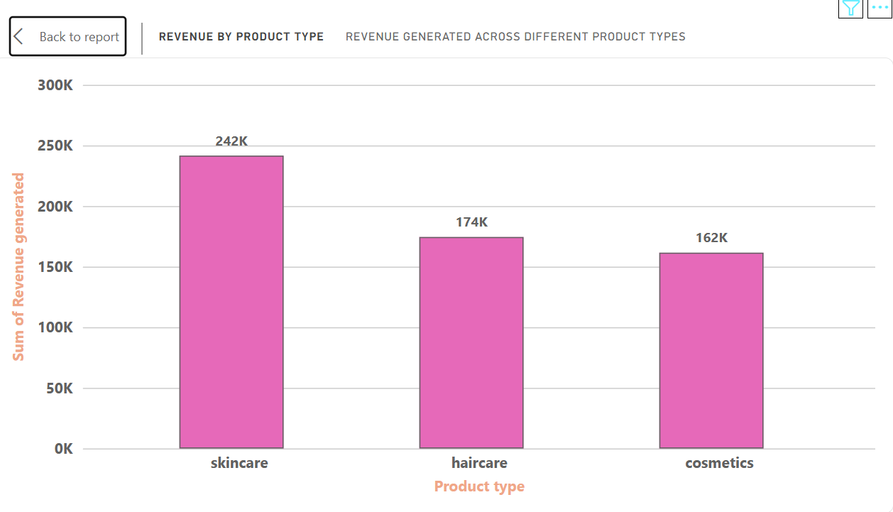
Revenue Performance by Product Type
Key Observation
Skincare is the leading revenue-generating product category.
Haircare ranks second in revenue contribution.
Cosmetics records the lowest revenue among the three categories.
Diagnostic Insight
The strong revenue contribution from Skincare indicates that it is an important category for overall business performance.

Slide 6
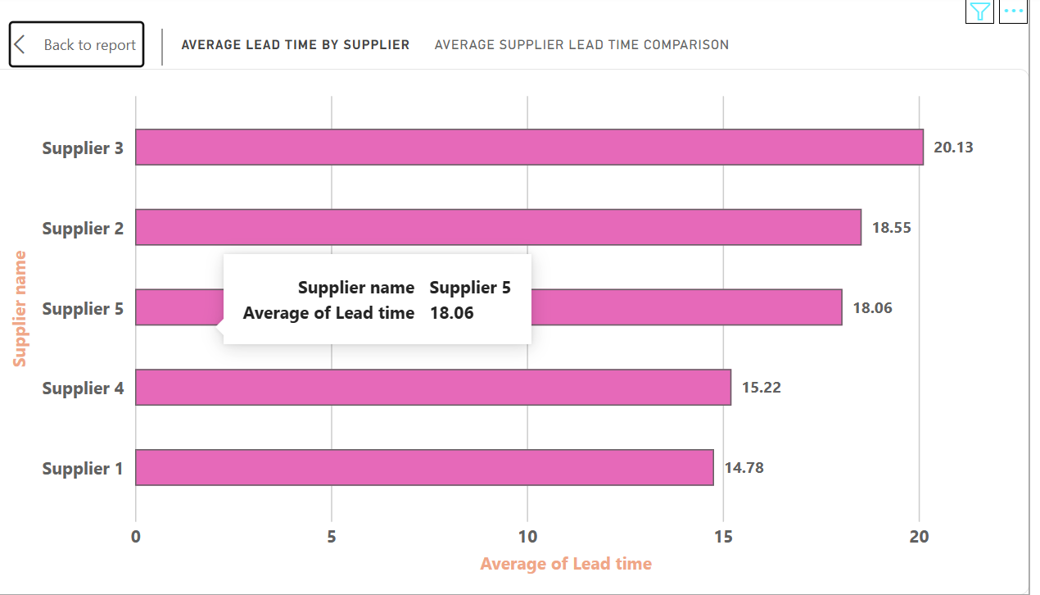
Supplier Lead-Time Analysis
Key Observation
Supplier 3 has the longest average lead time.
Supplier 1 has the shortest average lead time.
The difference indicates variation in supplier delivery performance.
Diagnostic Insight
Supplier 3 may require closer monitoring because longer lead times can affect planning and inventory availability.

Slide 7
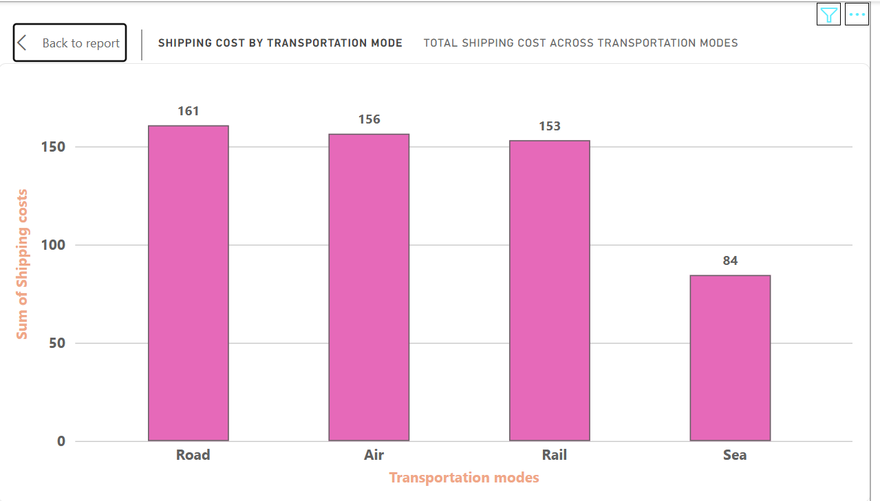
Transportation Cost Analysis
Key Observation
Road has the highest total shipping cost.
Air and Rail have similar cost levels.
Sea has the lowest shipping cost.
Diagnostic Insight
Transportation mode has a noticeable effect on supply-chain expenditure. Reviewing high-cost transportation options could help control logistics expenses.

Slide 8
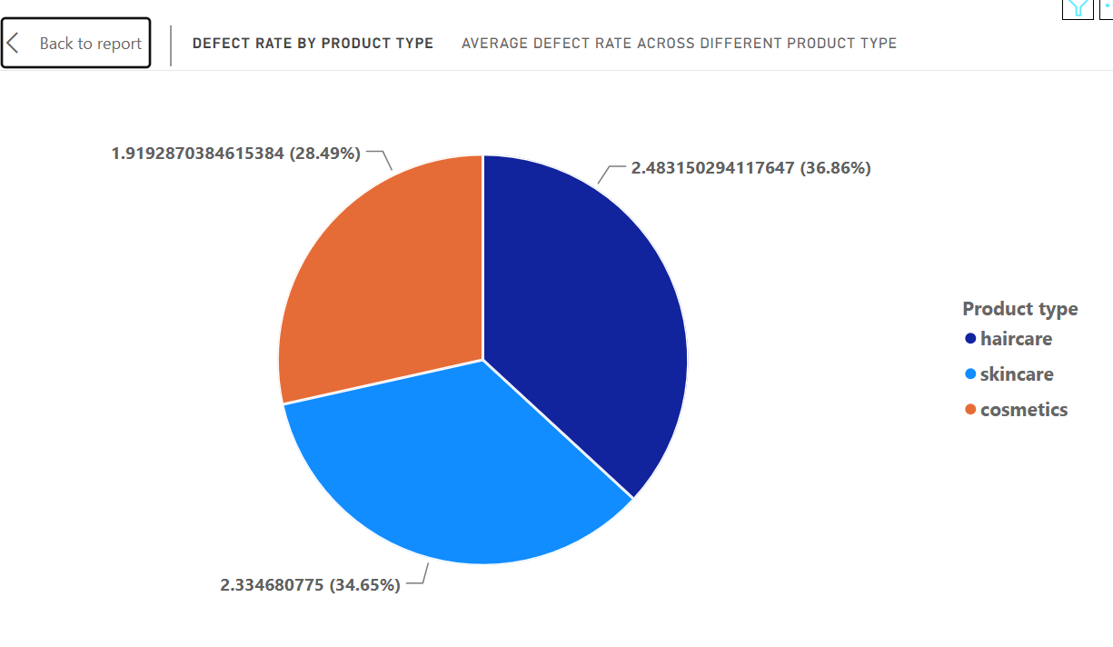
Product Quality & Defect Analysis
Key Observation
Haircare has the highest defect rate.
Skincare has a slightly lower defect rate.
Cosmetics has the lowest defect rate.
Diagnostic Insight
Haircare represents the main quality concern and may require further investigation into production and inspection processes.

Slide 9
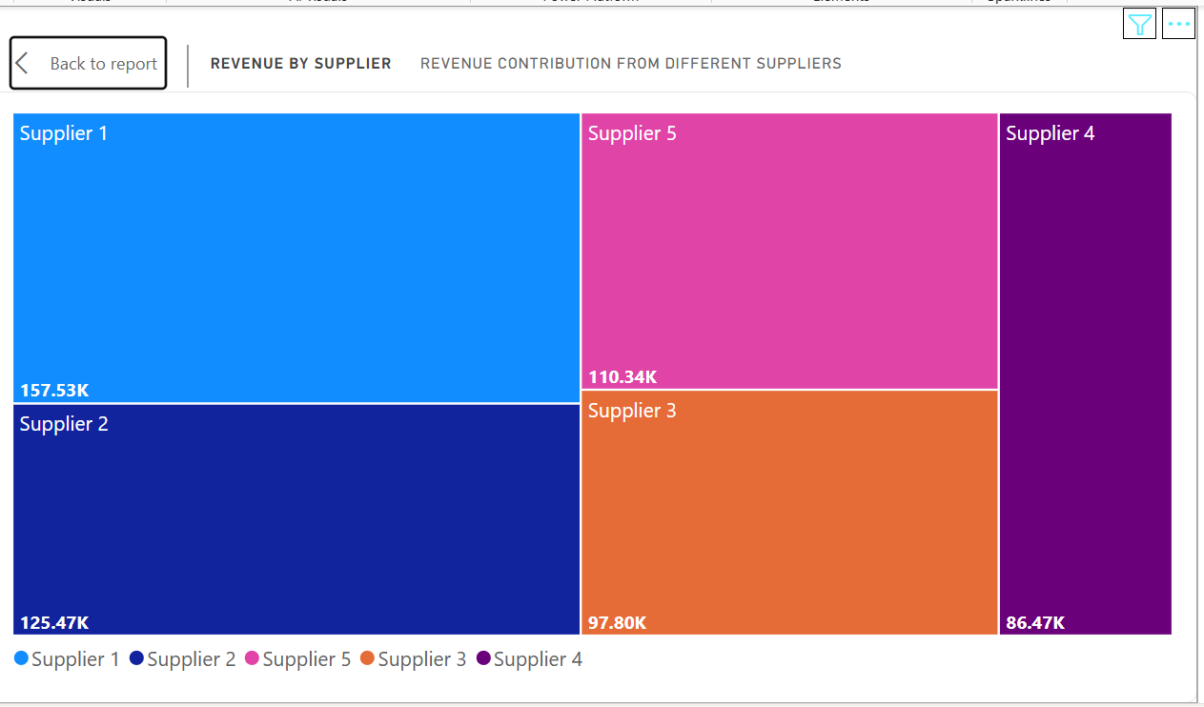
Revenue Contribution by Supplier
Key Observation
Supplier 1 contributes the highest revenue.
Supplier 4 contributes the lowest revenue.
Revenue contribution differs across suppliers.
Diagnostic Insight
Supplier performance should be evaluated using both business contribution and operational efficiency, rather than revenue alone.

Slide 10
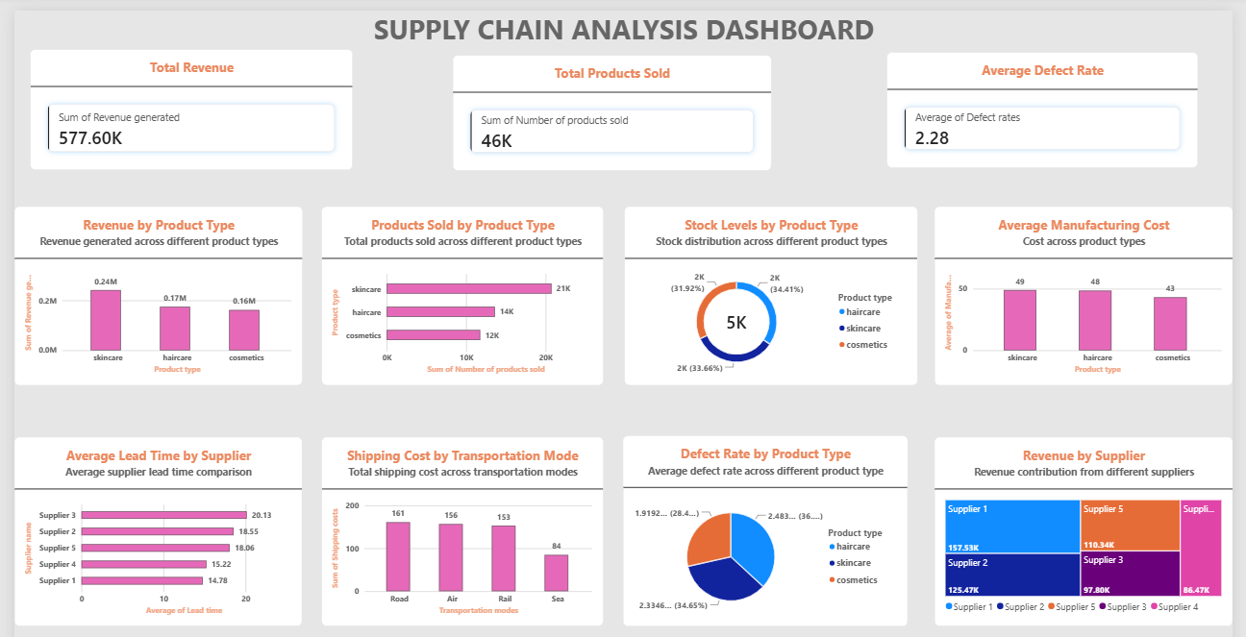
Supply Chain analysis Dashboard
The dashboard provides a consolidated view of sales, inventory, manufacturing, supplier, logistics and quality performance.

Slide 11
Major Diagnostic Findings
01 — PRODUCT PERFORMANCE
Skincare is the strongest revenue-generating category.
02 — SUPPLIER EFFICIENCY
Supplier 3 has the longest average lead time.
03 — LOGISTICS COST
Road transportation has the highest shipping cost.
04 — QUALITY
Haircare has the highest defect rate.
05 — SUPPLIER CONTRIBUTION
Supplier 1 contributes the highest revenue.
These findings highlight the key areas requiring management attention.

Slide 12
Recommended actions
1. Improve supplier management
Closely monitor suppliers with longer lead times.
2. Focus on quality improvement
Investigate the causes of higher Haircare defects.
3. Control transportation costs
Review high-cost transportation options and compare alternatives.
4. Monitor supplier performance
Evaluate suppliers using both revenue contribution and lead-time performance.
5. Maintain focus on strong products
Continue effective planning for high-performing categories such as Skincare.

Slide 13
Conclusion
The analysis provides visibility into major supply-chain performance areas.
Supplier efficiency, logistics cost and product quality are the main areas requiring attention.
Power BI helps convert the data into actionable insights for better supply-chain decisions.
“Better visibility leads to better supply-chain decisions.”

Slide 14
THANK YOU

